Slide 1
Machine Learning Miniproject
Ondrej Spetko

Slide 2
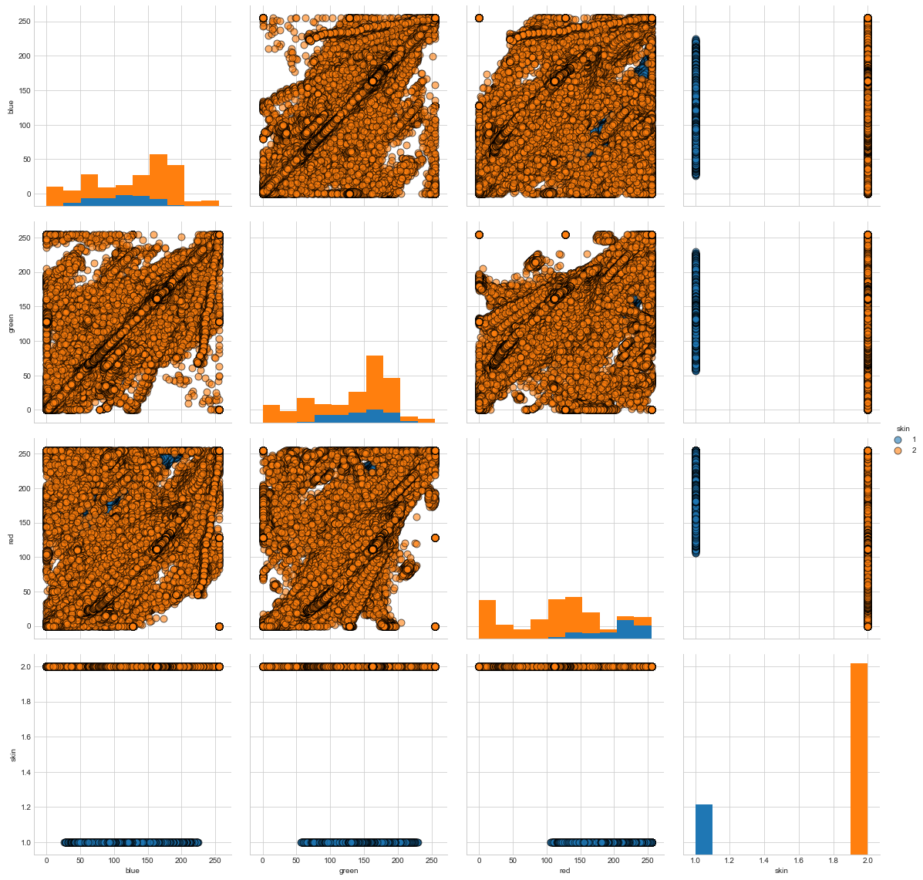
Data
Skin dataset
4 features (1 label)

Slide 3
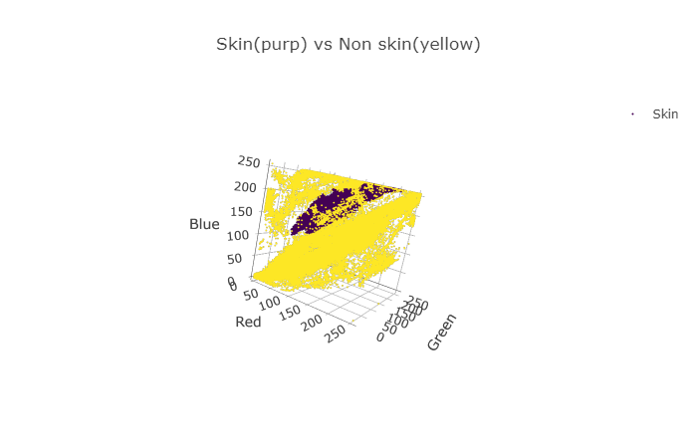
Data
3 Continuous numeric values (RGB), 1 ordinal value (label:skin)

Slide 4
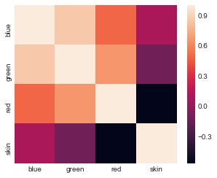
Data
Correlation

Slide 5
Data
Mean
blue 125.065654
green 132.507521
red 123.177151
Std
blue 62.255694
green 59.941243
red 72.562313

Slide 6
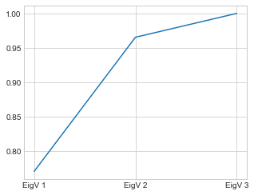
PCA
Eigenvalues
Eigenvalues 1&2 : ~97% rep. of data

Slide 7
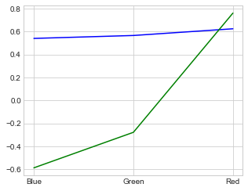
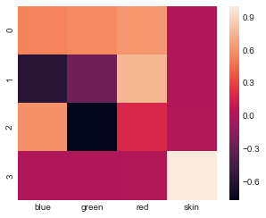
PCA
Eigenvectors/components

Slide 8
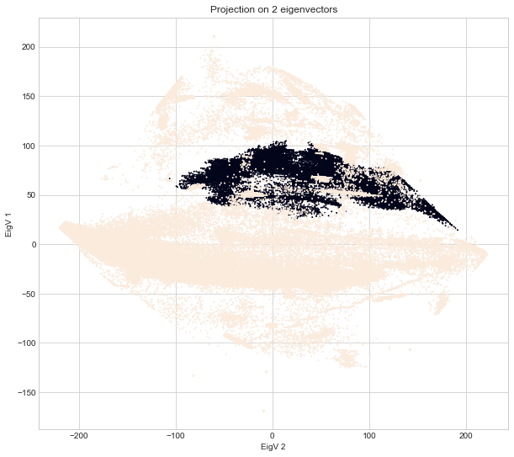
PCA
Projecting data on the 2 main eigenvectors
Centered data

Slide 9
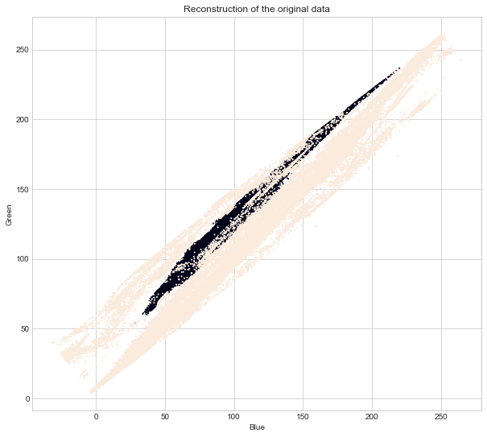
PCA
Reconstruction of the data

Slide 10
Classifiers
2 scaled datasets
Original dataset (3 features: RBG)
PCA product (2 features: BG)
Datasets split into train and test samples 2:1 (33% test)

Slide 11
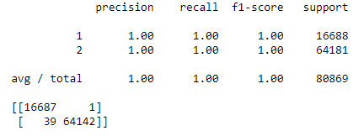
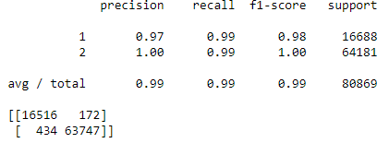
Non-parametric classifier k-nearest neighbor
Original > PCA

Slide 12
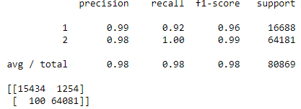
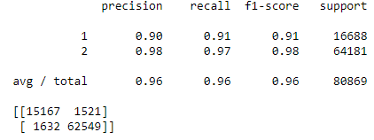
Parametric classifier QDA
Original > PCA

Slide 13
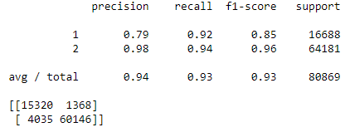
Parametric classifier LDA
Original <= LDA

Slide 14
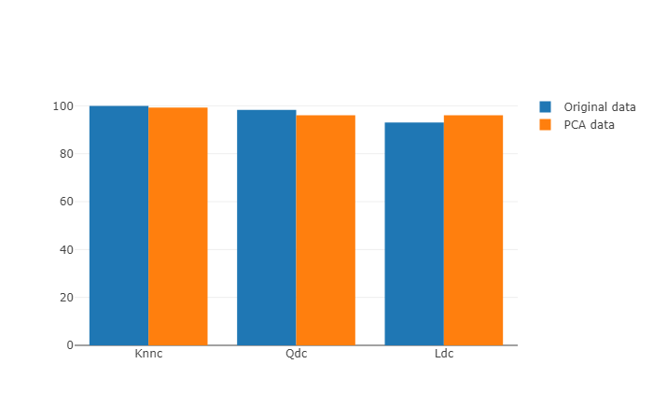
Classifiers

